Slide 1
DOTS AND BOXES: AI
Dots and Boxes is a two player complete information partisan game which is played on paper.

Slide 2
It means that from the start of the game, we can tell which of the possible moves, the other player can make.
By partisan means if some player starts first, then his probability of winning the game is high if and only if he plays optimally.

Slide 3
HOW TO PLAY THE GAME
Starting with an empty grid of dots, two players take turns adding a single horizontal or vertical line between two unjointed adjacent dots.
The player who completes the fourth side of a 1×1 box earns one point and takes another turn. (A point is typically recorded by placing a mark that identifies the player in the box, such as an initial).
The game ends when no more lines can be placed. The winner is the player with the most points. The board may be of any size. When short on time, a 2×2 board (a square of 9 dots) is good for beginners. A 5×5 is good for experts.

Slide 4
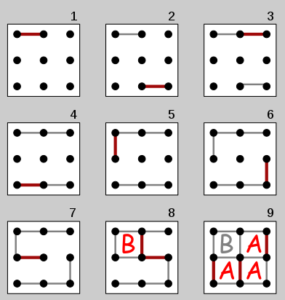
The diagram on the right shows a game being played on the 2×2 board. The second player (B) plays the mirror image of the first player's move, hoping to divide the board into two pieces and tie the game. But the first player (A) makes a sacrifice at move 7 and B accepts the sacrifice, getting one box. However, B must now add another line, and connects the center dot to the center-right dot, causing the remaining boxes to be joined together in a chain (shown at the end of move 8). With A's next move, player A gets them all and wins 3–1.

Slide 5
IMPLEMENTATION OF AI
To implement the artificial intelligence of the game, we use minimax algorithm, alpha-beta pruning and short depth heuristics.
First, the back-end interface was designed in C-programming language which included the data-structures for board, move and some utility functions.

Slide 6
MINIMAX ALGORITHM
Minimax (sometimes MinMax or MM) is a decision rule used in decision theory, game theory, statistics and philosophy for minimizing the possible loss for a worst case (maximum loss) scenario.
When dealing with gains, it is referred to as "maximin"—to maximize the minimum gain.
Originally formulated for two-player zero-sum game theory, covering both the cases where players take alternate moves and those where they make simultaneous moves, it has also been extended to more complex games and to general decision-making in the presence of uncertainty.

Slide 7
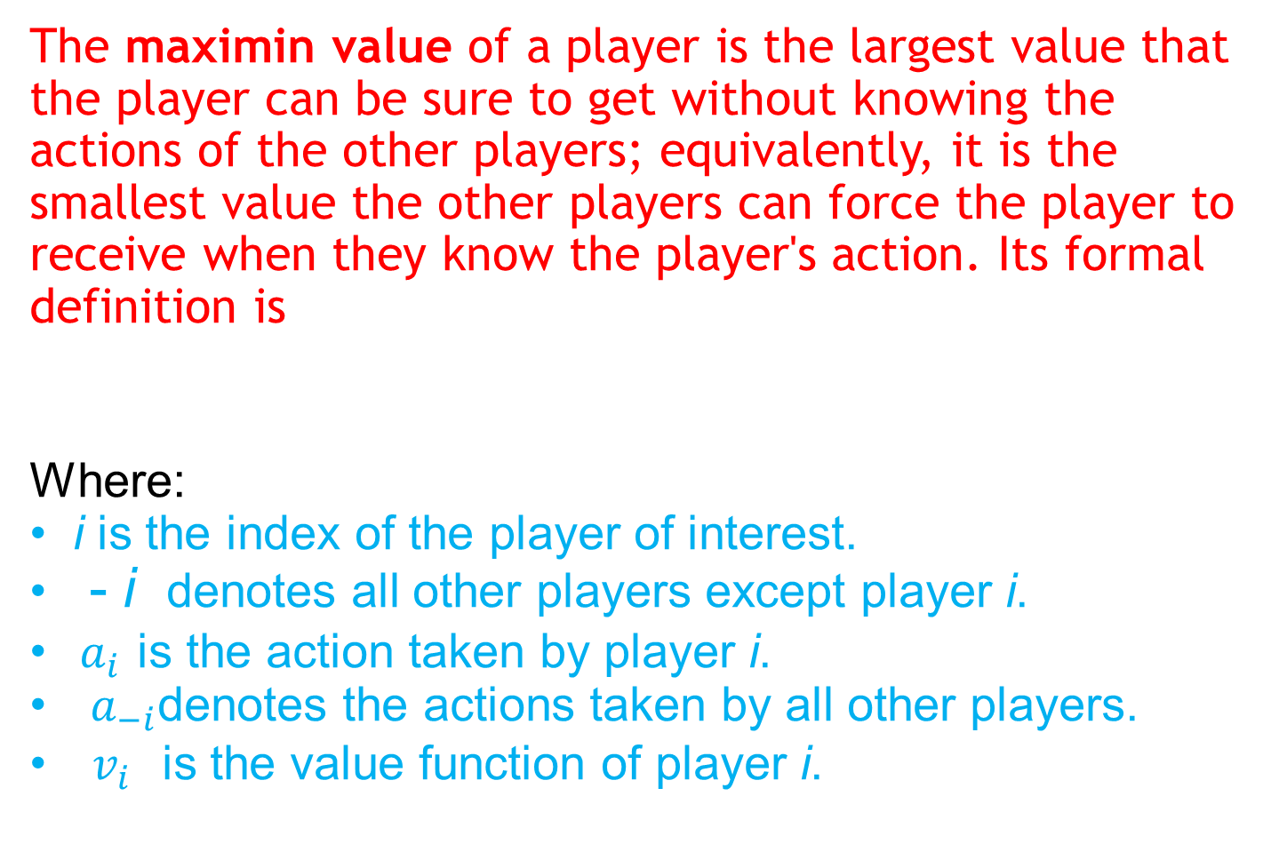


Slide 8
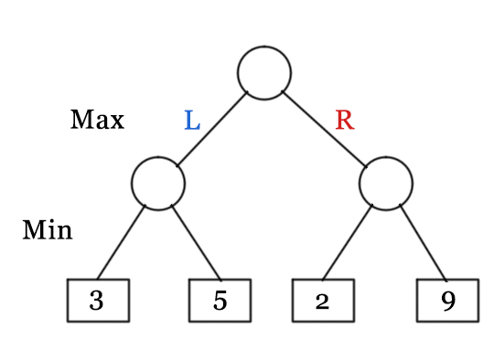
DIAGRAM: ROOT NODE HAS VALUE = 3

Slide 9
ALGORITHM
01 function minimax(node, depth, maximizingPlayer)
02 if depth = 0 or node is a terminal node
03 return the heuristic value of node
04 if maximizingPlayer
05 bestValue := −∞
06 for each child of node
07 v := minimax(child, depth − 1, FALSE)
08 bestValue := max(bestValue, v)
09 return bestValue
10 else (* minimizing player *)
11 bestValue := +∞
12 for each child of node
13 v := minimax(child, depth − 1, TRUE)
14 bestValue := min(bestValue, v)
15 return bestValue

Slide 10
ALPHA-BETA PRUNING
This is just a little modification to minimax algorithm in which we use two variables alpha and beta where alpha is the maximum value player 1 can achieve in its run and beta is the minimum value which player 2 can achieve. They are initialized to their worsts i.e. -∞ and +∞ respectively. Finally, we stop the minimax algorithm when beta ≤ alpha and the values of alpha and beta change as follows.
alpha = max (alpha, v ) and beta = min(beta, v)

Slide 11
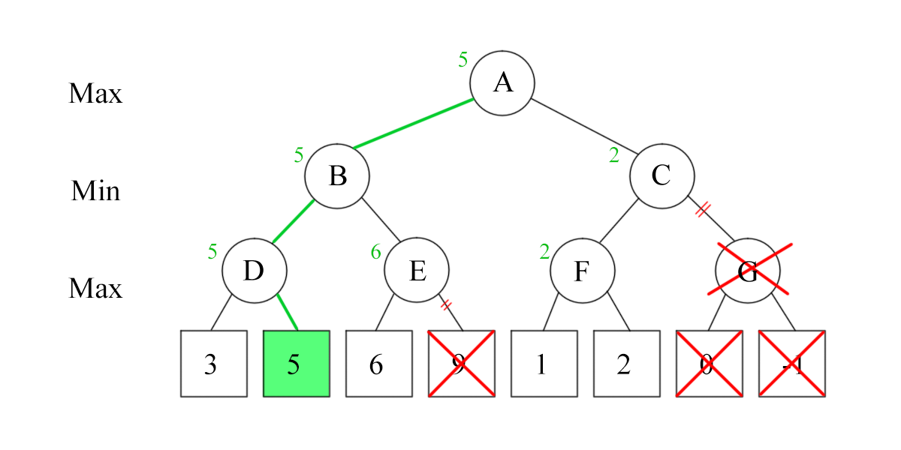
DIAGRAM

Slide 12
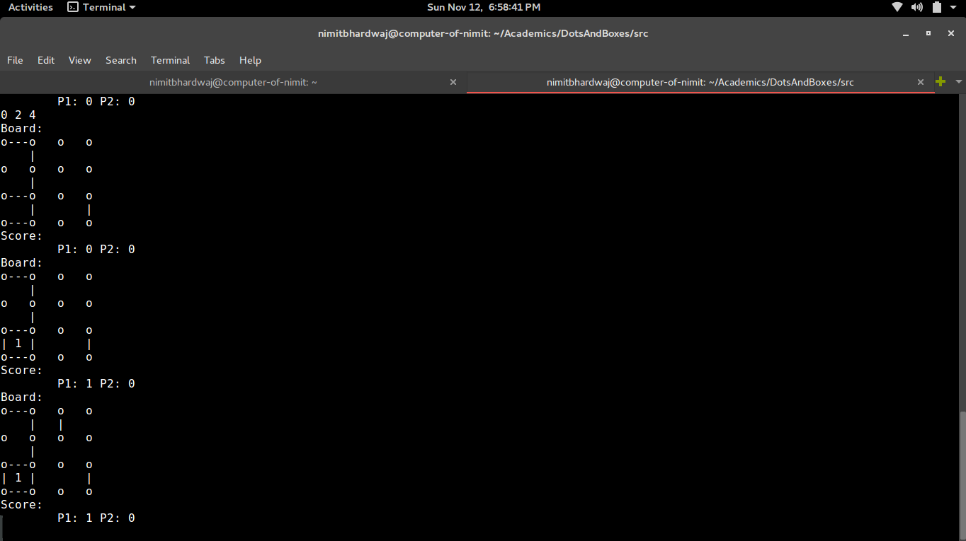
MY IMPLEMENTATION RUN

Slide 13
THANKS FOR YOUR PATIENCE

